Slide 1
CS5220 Advanced Topics in Web Programming
Spring – Inversion of Control
Chengyu Sun
California State University, Los Angeles

Slide 2
Spring Framework
The most popular Java web framework (according to hotframeworks.com)
  Performance, reliability, security, support, …
Concepts and methodologies that are important not just for web development, but for software development in general

Slide 3
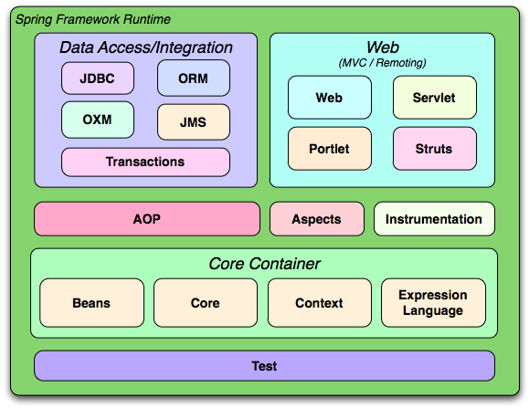
The IoC Container

Slide 4
The Need for IoC
The DAO Example
  The Data Access Object (DAO) pattern
  UserDao Example
    Model class
    Interface
    Implementation
    Usage in application code

Slide 5
Model Class
public class User {
private Integer id;
private String username, password;
private boolean enabled;
}

Slide 6
DAO Interface
public interface UserDao {
User getUser( Integer id );
List<User> getUsers();
}

Slide 7
DAO Implementation
Implement UserDao using JPA
public class UserDaoImpl implements UserDao {
private EntityManager entityManger;
public User getUser( Integer id )
{
return entityManager.find(User.class, id );
}
... ...
}

Slide 8
DAO Usage in Application Code
UserController
public class UserController {
UserDao userDao;
public String users( ModelMap models )
{
List<User> users = userDao.getUsers();
… …
}
}

Slide 9
Data Access Object (DAO)
A Java EE design pattern
Persistent
Data
Store
DAO
controller
model
user
view
Application code

Slide 10
Advantages of DAO
Provide a data access API that is
  Independent of persistent storage types, e.g. relational DB, OODB, XML, flat files etc.
  Independent of persistent storage implementations, e.g. MySQL, PostgreSQL, Oracle etc.
  Independent of data access implementations, e.g. JDBC, Hibernate, etc.

Slide 11
Instantiate a UserDao Object in Application Code
1.
UserDaoJpaImpl userDao =
new UserDaoJpaImpl();
2.
UserDao userDao =
new UserDaoJpaImpl();
Which one is better??

Slide 12
Problem Caused by Object Instantiation
What if we decide to use JDBC instead of Hibernate/JPA, i.e. replace UserDaoJpaImpl with UserDaoJdbcImpl
  The application is not really independent of the data access method
  Switching to a different UserDao implementation affects all the code that instantiates UserDao

Slide 13
Another Way to Instantiate UserDao
UserDao userDao;
...
public void setUserDao( UserDao userDao)
{
this.userDao = userDao;
}
No more dependency on a specific implementation of the DAO
But who will call the setter?

Slide 14
Inversion of Control (IoC)
A framework like Spring is responsible for instantiating the objects and pass them to application code
  A.K.A. IoC container, bean container
Inversion of Control (IoC)
  The application code is no longer responsible for instantiate objects like DAO, i.e. that “control” is taken way from the application code
  A.K.A. Dependency Injection

Slide 15
Example: Hello World
Message is a Java object (or bean) managed by the Spring container
  Created by the container
  Property is set by the container

Slide 16
Bean Configuration File
<beans>
<bean id="msgBean“
class=“cs520.spring.hello.Message">
<property name="content" value="Hello World!" />
</bean>
</beans>
The string “Hello World” is injected to the bean msgBean

Slide 17
Understand Bean Container …
Without a bean container
Application Code
new Message()
Message
object
JVM

Slide 18
… Understand Bean Container
With a bean container
Application Code
getBean(“msgBean”)
<bean id="msgBean“
class="cs520.spring.hello.Message">
<property name=“content“
value="Hello World!" />
</bean>
setContent(“Hello World!”);
Bean Container
Message
object
new Message()
JVM

Slide 19
Dependency Injection
Objects that can be injected
  Simple types: strings and numbers
  Collection types: list, set, and maps
  Other beans
Methods of injection
  via Setters
  via Constructors

Slide 20
Dependency Injection Example
DjBean
  Fields of simple types
  Fields of collection types
  Fields of class types

Slide 21
Quick Summary of Bean Configuration
Bean | <bean>, “id”, “class”
Simple type property | <property>, “name”, “value”
Class type property | <property>, “name”, “ref” (to another <bean>)
Collection type property | <list>/<set>/<map>/<props>, <value>/<ref>/<entry>/<prop>
Constructor arguments | <constructor-arg>, “index”, same as other properties

Slide 22
Some Bean Configuration Examples
<property name=“foo”>
<map>
<entry key=“key1”>
<value>bar1</value>
</entry>
<entry key=“key2”>
<ref bean=“bar2” />
</entry>
</map>
</property>
<property name=“foo”>
<set>
<value>bar1</value>
<ref bean=“bar2” />
</set>
</property>
<property name=“foo”>
<props>
<prop key=“key1”>bar1</prop>
<prop key=“key2”>bar2</prop>
</props>
</property>

Slide 23
Wiring – The Stack Example (I)
Stack1
StackTest

Slide 24
Wiring – The Stack Example (II)
StackTest
ArrayList
Stack2
LinkedList

Slide 25
Wiring – The Stack Example (III)
StackTest
ArrayList
Stack2
LinkedList

Slide 26
Annotation-based Configuration
Activate annotation processing with <context:annotation-config />
Automatically scan for Spring bean with <context:component-scan />
Mark a class to be a Spring bean with @Component
Enable auto wiring with @Autowired

Slide 27
XML Namespace …
<?xml version="1.0" encoding="UTF-8"?>
<beans xmlns="http://www.springframework.org/schema/beans"
xmlns:xsi="http://www.w3.org/2001/XMLSchema-instance"
xmlns:context="http://www.springframework.org/schema/context"
xsi:schemaLocation="http://www.springframework.org/schema/beans
http://www.springframework.org/schema/beans/spring-beans-3.0.xsd
http://www.springframework.org/schema/context
http://www.springframework.org/schema/context/spring-context-3.0.xsd">
<context:annotation-config />
<context:component-scan base-package="cs520.spring.stack" />
</beans>

Slide 28
… XML Namespace
<?xml version="1.0" encoding="UTF-8"?>
<beans:beans xmlns=" http://www.springframework.org/schema/context "
xmlns:xsi="http://www.w3.org/2001/XMLSchema-instance"
xmlns:beans="http://www.springframework.org/schema/beans"
xsi:schemaLocation="http://www.springframework.org/schema/beans
http://www.springframework.org/schema/beans/spring-beans-3.0.xsd
http://www.springframework.org/schema/context
http://www.springframework.org/schema/context/spring-context-3.0.xsd">
<annotation-config />
<component-scan base-package="cs520.spring.stack" />
</bean:beans>

Slide 29
<context:annotation-config>
Activate the processing of a number of annotations, e.g.
  @Autowired
  @Qualifier
  @Resource
  @PersistenceContext

Slide 30
<context:component-scan>
Scan all the classes under base-package and its sub-packages

Slide 31
Annotating Bean Classes
@Component for regular bean classes
@Repository for DAO classes
@Controller for controller classes
@Service for service classes

Slide 32
Auto Wiring
Auto wire types
  byName, byType, autodetect, constructor
For individual bean
  <bean autowire=“autowire type”/>
For all beans
  <beans default-autowrire=“autowire type”>

Slide 33
@Autowired
The property does not need a setter
Auto wired by type
To auto wire by name
  Use @Qualifier
  Use @Resource

Slide 34
Advantages of IoC
True separation of different components of an application
Centralized bean dependency management
Singleton objects improve performance
  Singleton vs. Prototype

Slide 35
Readings
Spring Framework – Core
  Chapter 1. The IoC Container

